Slide 1
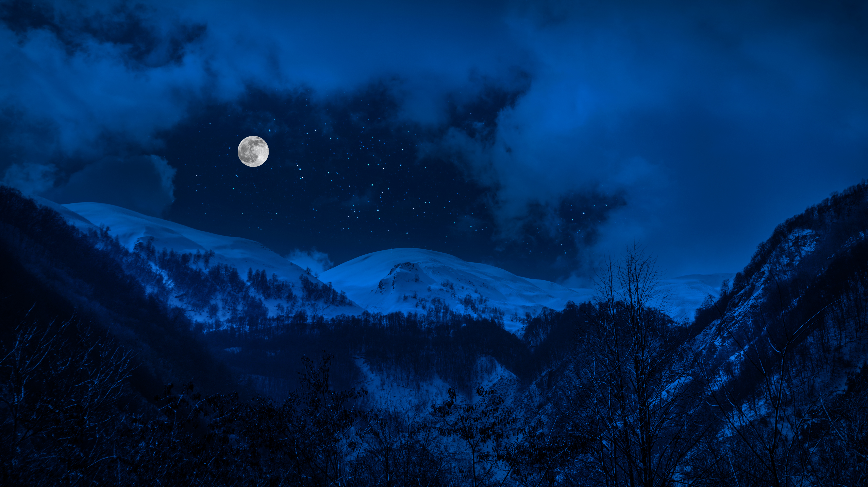

From Ukrainian Moonshine to Azure CosmosDB
Olena Borzenko
@borzenko_lena
Notes:
Welcome and good evening! I hope everyone is doing amazing! First of all, I want to say that this is unfortunate that we couldn’t meet in person. But we are living in a challenging period and have to adjust. So safety first and hopefully that next time we will have an opportunity to chat while having a cup of coffee together. However, I feel honored that 4DtNet invited me to be here today and share the stage with amazing speakers such Jan and Eduard. Also that I still can deliver the session no matter what. So I have to keep going due to a time limitations but I’m always happy and open to a conversation. And now it’s a good time to start my talk. I bet there might be a bit of confusion how Ukrainian Moonshine related to Azure CosmosDB or tech in general. If anyone had some thoughts or assumptions, please let me know, I’m very curious. But meanwhile, I will start from a story of discovering my passion to technologies and programming.

Slide 2



@borzenko_lena
Notes:
Some of you you might have seen me on some online events or by now at a few in person conferences. In any case my name is Olena Borzenko. live in berlin, challenging 3 years I’m speaker education But I chose this field only after careful consideration of the next steps. To put it in other words I knew I’ll go in a direction of information technologies long time before. Of course, I didn’t spend a single second on learning how to code because I always thought there is tomorrow and Monday and from next week. So I’d say that my journey as a programme, had a beginning after I got my degree. I have to mention that I owe big part of my intrest in a programming to my older sister. Initially I wasn’t that much into tech but her passion and curiosity motivated and inspired me.

Slide 3
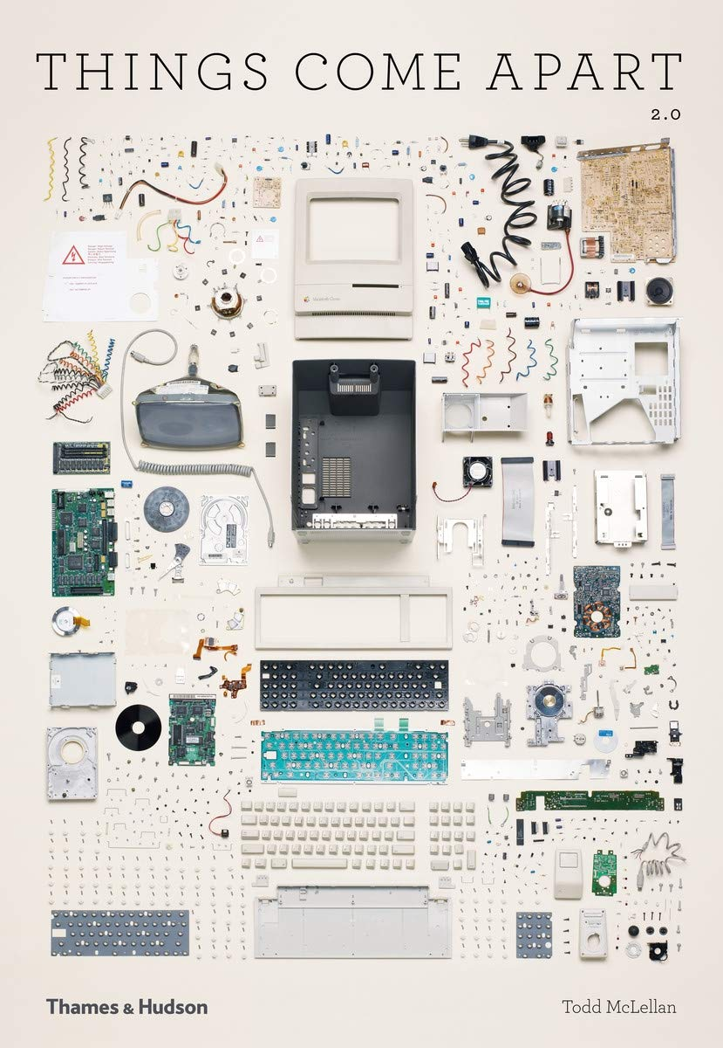
Todd McLellan
Things Come Apart 2.0 A Teardown Manual for Modern Living
Notes:
Scrolling through the internet I bumped into this picture that reminded me of some childhood memmories. Where my sis was taking appart a new computer. Parents shoked. She also liked to teach me coding despire my apathy to this topic back then.

Slide 4


Notes:
I do remember very well my first lines of code. My sister gave me a booklet about HTML5. Happy to write and launch in browser. It was like a magic for me that I can create something by writing some text in a notepad. But that was about it.

Slide 5
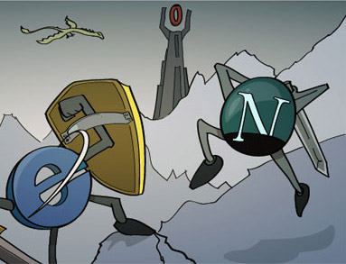
Notes:
Microsoft released Internet Explorer 2.0 on November 22, 1995, and officially started the browser war with Netscape. Browser War I had been more of a coup – when half the Mosaic team defected in early 1994 and formed Netscape under entrepreneur Jim Clark, Mosaic lasted less than a year. But when Microsoft licenses a version of Mosaic and rebrands it Internet Explorer, the fight is on. In the mid to late 1990s Netscape revolutionizes the business model for the Web, and helps it spread to ordinary people as well as businesses.
But Microsoft gives away Explorer free with every copy of Windows 95 and beyond, and by the end of the 1990s Netscape is failing. As a last-ditch strategy the code for Netscape's Navigator browser gets converted to open source, and becomes the basis of the Mozilla Foundation and its Firefox browser today.

Slide 6









Notes:
PHP, Ruby ,Visual Basic, IE, Opera, Gimp, Idrive, Perl, Javascript

Slide 7
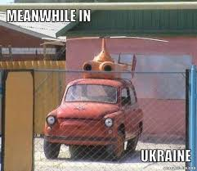

Slide 8
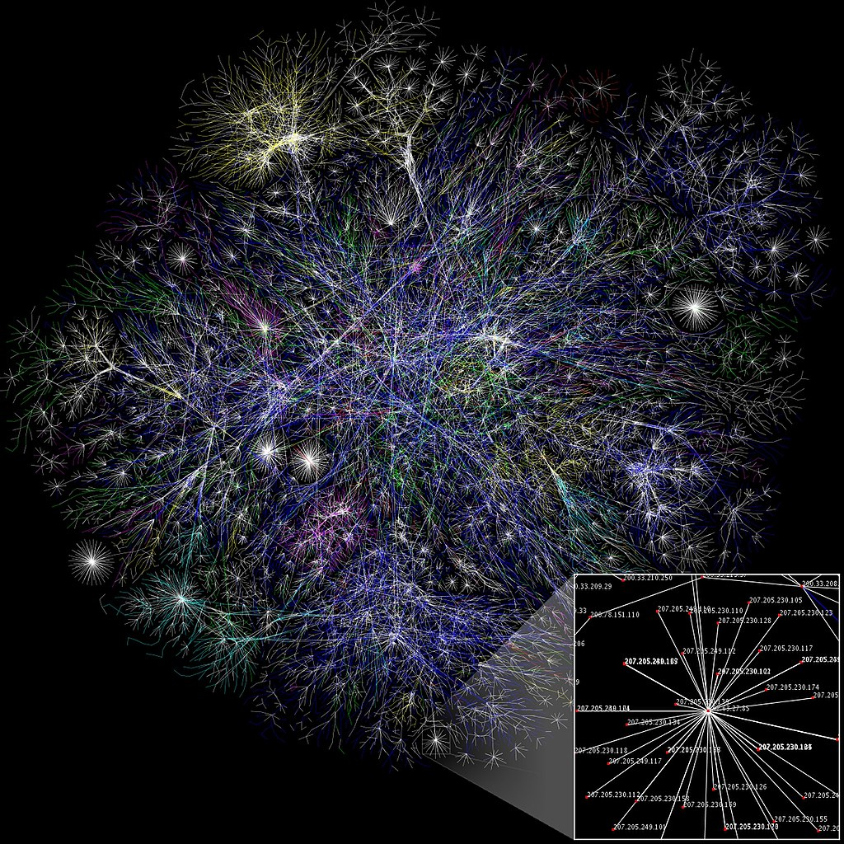
At the end of 2000, internet become generally available for home users in Ukraine
Visualization from the Opte Project of the various
routes through a portion of the Internet in 2005
Notes:
to generate an accurate representation of the breadth of the Internet using visual graphics 1996 countries wanted to import pc but because of ISO certification it was complicated

Slide 9
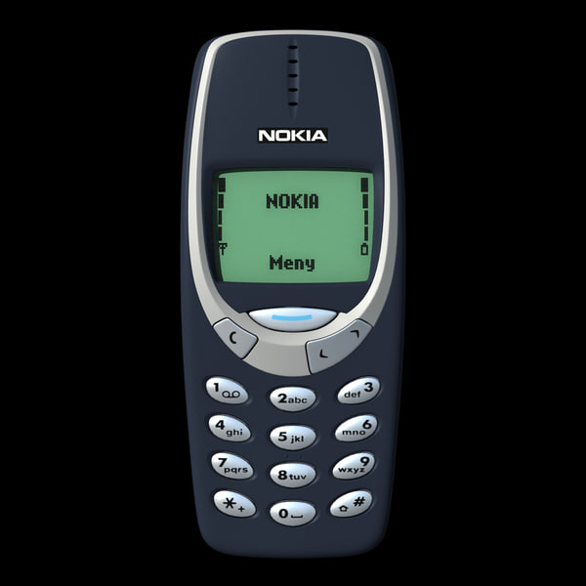
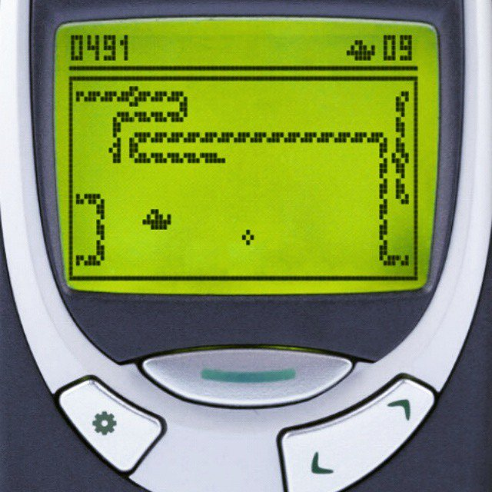
Notes:
Nookia 3310 Mobile payments were trialed in 1998 in Finland and Sweden where a mobile phone was used to pay for a Coca-Cola vending machine and car parking. Commercial launches followed in 1999 in Norway. The first commercial payment system to mimic banks and credit cards was launched in the Philippines in 1999 simultaneously by mobile operators Globe and Smart. Also some believe that the first online purchase was in 1994 ( a pepperoni and mushroom pizza from Pizza Hut, occurs in this year.)

Slide 10
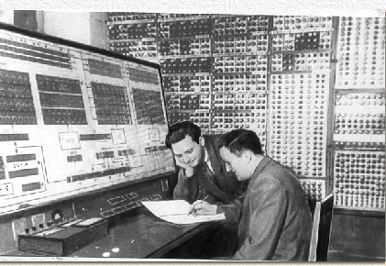
The MESM (1951, Kyiv, Ukraine) First universally programmable electronic computer in Europe
Created the supervision of:
Sergey Alekseevich Lebedev
“Stop torturing the machine,
it’s the people who are wrong!”
Small Electronic Computing Machine
Notes:
Two famous Kyiv mathematicians, S.G. Krein and S.A. Avramenko came up with a pilot task for the machine (relating to ballistics) and calculated the answer themselves first, as a check on MESM’s results. When the machine gave an answer different from the mathematicians’ solution, everyone assumed that MESM had malfunctioned, since it would be highly unlikely for two people to make a mistake in the same exact spot in the calculations. Lebedev, however, decided to test the results himself. The next morning, after working through the task by hand, he showed up smiling, which was a rare occurrence. He said, “Stop torturing the machine, it’s the people who are wrong!” Apparently, the two mathematicians did indeed make a mistake simultaneously, meaning the machine turned out to be “smarter” than man!

Slide 11
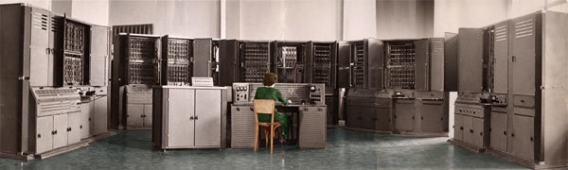
Kateryna Yushchenko Address programming language for computer “Kyiv”, 1955
Notes:
USSR crush that lead to a break in progress Kateryna Yushchenko (Ukraine) created the Address programming language for the cоmputer "Kyiv" in 1955 and invented indirect addressing of the highest rank (invented Pointers).^{[88]} The Address language affected not only the Soviet Union's and other socialist countries economical development, but information technology and programming of over the world. APL's proposed and implemented ideas and tools can be found in many programming-related fields, such as abstract data types, object-oriented programming, functional programming, logical programming, databases and artificial intelligence. Starting in 1950 Kateryna became a Senior Researcher at the Kyiv Institute of Mathematics. There she had the chance to work on the MESM computer, one of the first computers in continental Europe. After seven years, in 1957, she was appointed Director of the Institute of Computer Science.

Slide 12

Era of Stagnation
Notes:
The era of stagnation started for Soviet union on 1964–1985. Until the dissolution of USSR there was a period of Perestroika. (political movement for reformation within) On 8 December 1991, the presidents of Russia, Ukraine and Belarus (formerly Byelorussia), signed the Belavezha Accords, which declared the Soviet Union dissolved and established the Commonwealth of Independent States (CIS) in its place. this period was the decline of Ukraine full of. Post union steriotypes and opinions of how everyone should be purchasing power was low due to the economical crisis and Ukraine was behind many other countries by tech progress

Slide 13
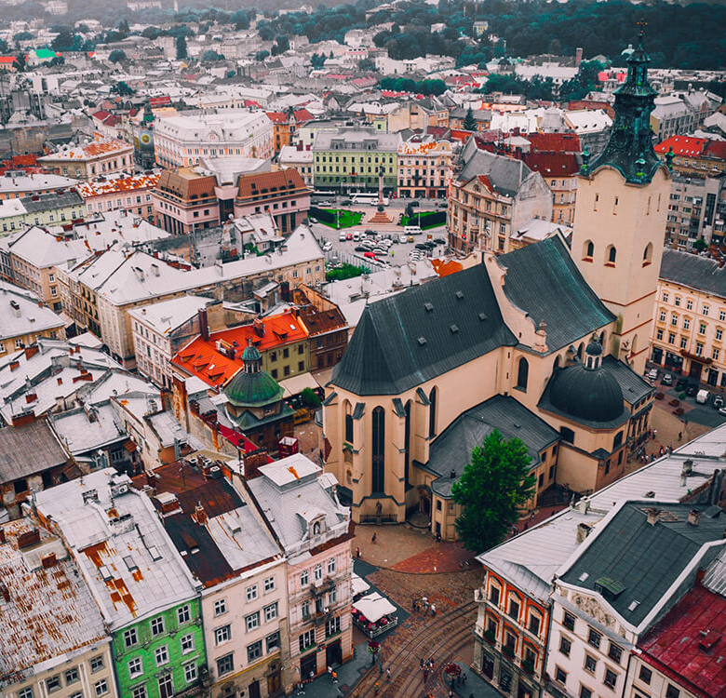
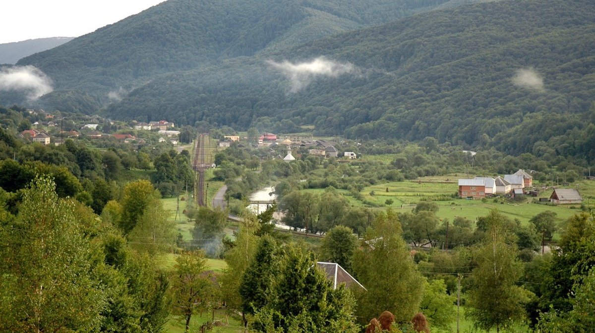
Notes:
And that was aproximatelly when I was in a high school chose wihtout hesitation village over the city

Slide 14

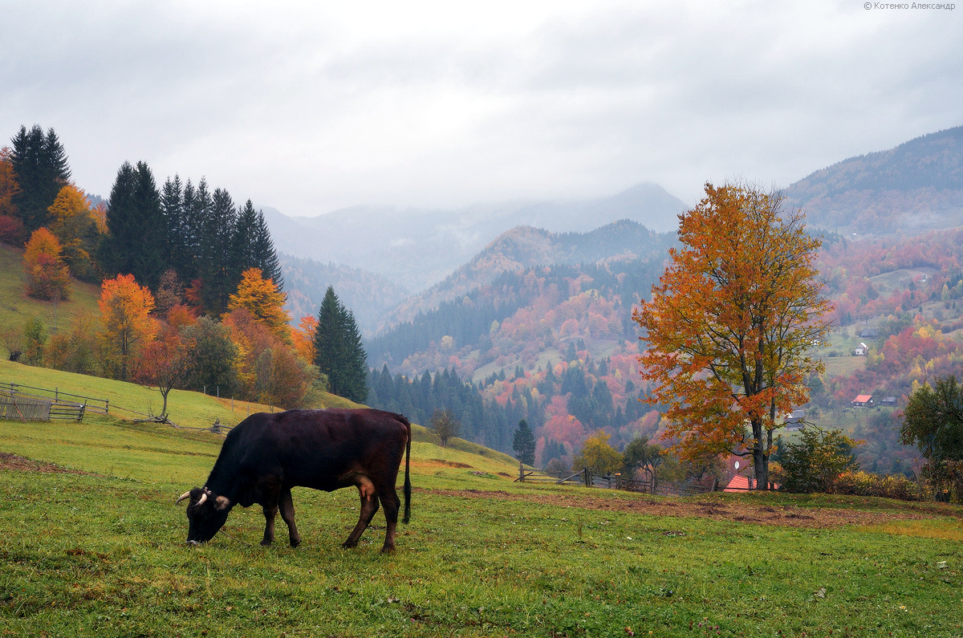
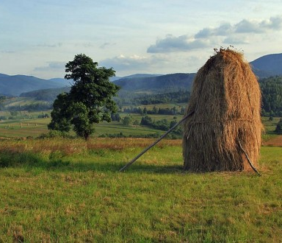

Notes:
I’ve been to some places where progres was either a bit ahead or behind.
But impression from my first visit to such a distant village among montains was on a different level. Odly I didn’t feel any discomfort and such a big gap in progress was very peacful and calming. I had a feeling that somewhere about a century ago time decided to take a short break.

Slide 15

Notes:
technological adoption Attainment gap of almost a century They also tend to be older and use new technology only if there is no other way to get their job done, or they will be penalized for not using it.
If the distribution frequency is correct, you should be aware that at least 50% of your target population may be actively resisting the technology you are introducing.

Slide 16

What about moonshine?

Slide 17


Slide 18
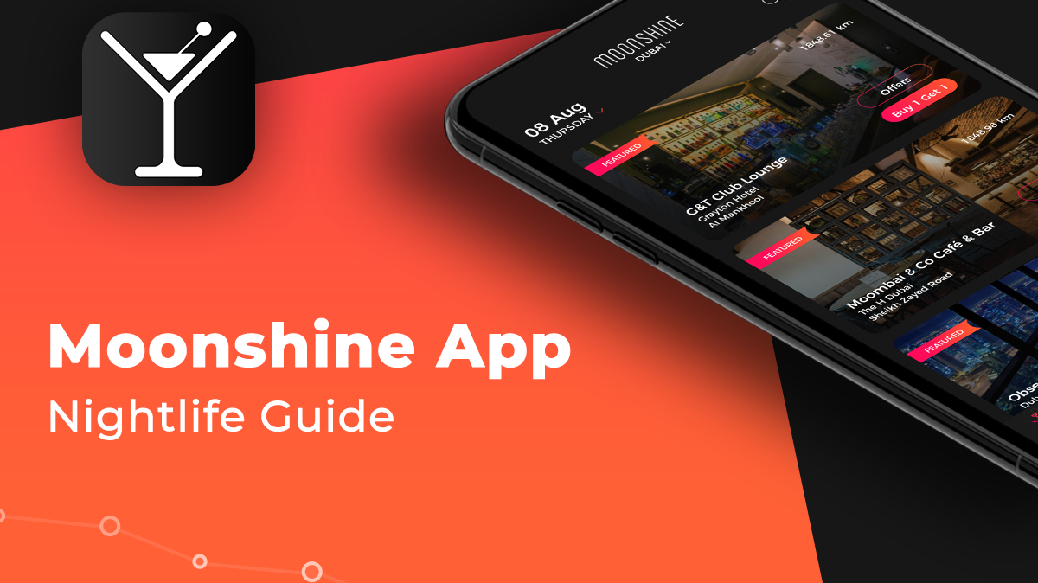

Slide 19
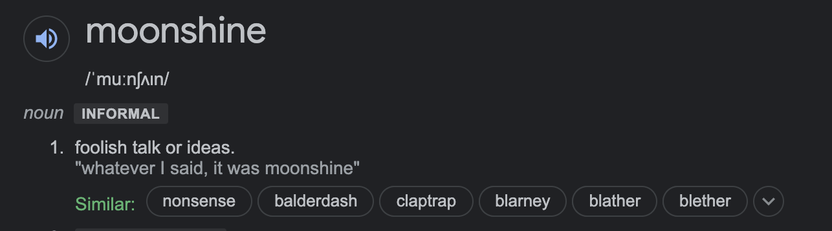

Slide 20
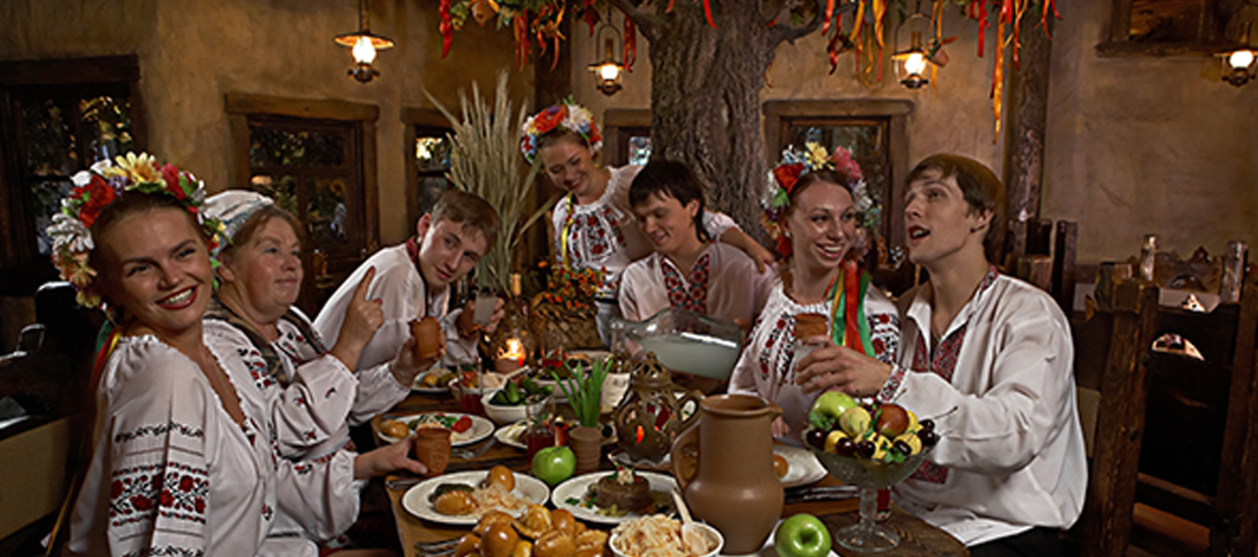
Part of the culture and tradition
Notes:
A lot of understaning of why tech is important

Slide 21

Notes:
Knowing how much the right tool can simplify someone’s life changed my understanding of software and technology importance

Slide 22

Notes:
I decided that i want to build tools that can have such an impact on peoples life

Slide 23

Notes:
The Azure cloud platform is more than 200 products and cloud services designed to help you bring new solutions to life—to solve today’s challenges and create the future. Build, run, and manage applications across multiple clouds, on-premises, and at the edge, with the tools and frameworks of your choice.

Slide 24
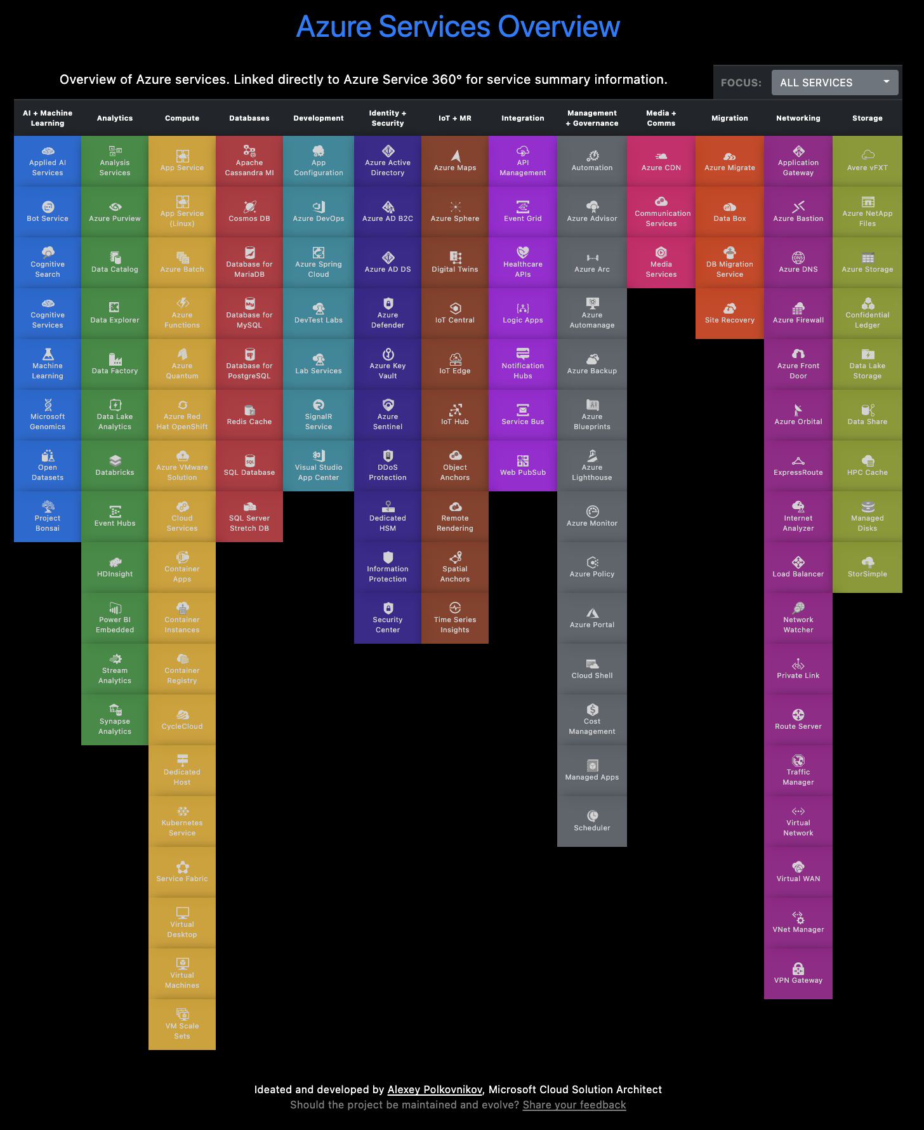
azurecharts.com/overview

Slide 25





Azure Cosmos DB
MongoDB
Table API
Column-family
Document
Key-value
Graph
Guaranteed low latency
Elastic scale out
Five consistency levels
Global distribution
Comprehensive SLAs
Notes:
missinterpreted

Slide 26
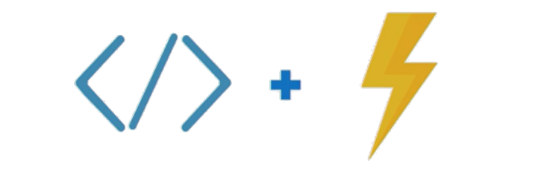
Azure Functions
Notes:
Azure Functions is a cloud service available on-demand that provides all the continually updated infrastructure and resources needed to run your applications. You focus on the pieces of code that matter most to you, and Functions handles the rest. Functions provides serverless compute for Azure. You can use Functions to build web APIs, respond to database changes, process IoT streams, manage message queues, and more.

Slide 27
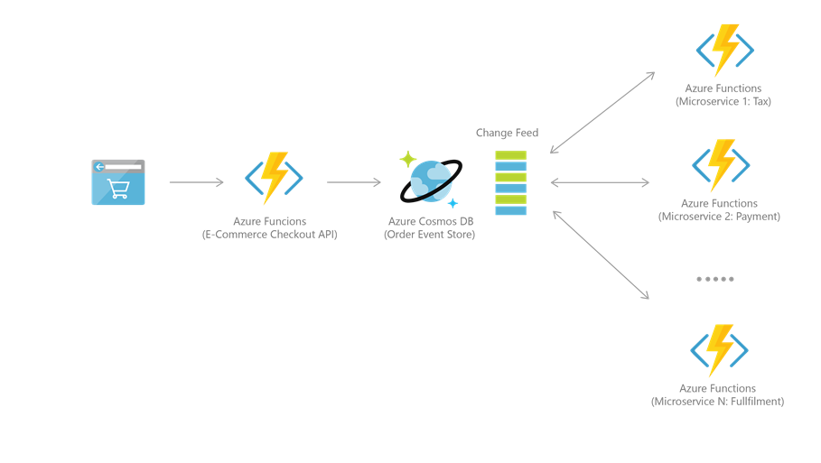
Notes:
Azure Cosmos DB is often used for event source to power event-driven architectures using the change feed functionality . The change feed provides downstream microservices the ability to read insertions and updates (for example, order events) to an Azure Cosmos DB in a reliable and incremental manner. This functionality can be used to provide a persistent event store as a message broker for state change events and order fulfillment workflow between many microservices (which can be implemented as serverless Azure Functions).

Slide 28










Event-Computing and Notification
Stream Processing
New events (writes)
Change feed
Data movement
Notes:
Notification hub, Azure app service Azure stream analytics, apache sparc, storm and Hdinsigts Data lake, storage blob, storage table .

Slide 29


Slide 30
Thank you!
Olena Borzenko
@borzenko_lena
in/olena-borzenko

